Slide 1
REGRESSION

Slide 2
Regression analysis is the primary technique to solve the regression problems in machine learning using data modelling. It involves determining the best fit line which is a line that passes through all the data points in such a way that distance of the line from each point is minimised.

Slide 3
Regression is a statistical method used in finance, investing and other disciplines that attempts to determine the strength and character of the relationship between one dependent variable (usually denoted by Y) and a series of other variables (known as independent variables.)
In statistical modelling, regression analysis is a set of statistical processes for estimating the relationships between a dependent variable and one or more independent variables.
Purpose: typically a regression analysis is done for one of two purposes: in order to predict the value of the dependent variable for individuals for whom some information concerning the explanatory variables is available, or in order to estimate the effect of some explanatory variable on the dependent variable.
6 types of regression models in machine learning are:
Linear regression, logistic regression, Ridge regression,Lasso regression, Polynomial regression, Baysian Regression.

Slide 4
Regression analysis is a predictive modelling technique that analyzes the relation between the target or dependent variable and independent variable in a dataset.The regression technique gets used mainly to determine the predictor strength, forecast trend, time series, and in case of cause & effect relation.
Regression analysis is the primary technique to solve the regression problems in machine learning using data modelling. It involves determining the best fit line, which is a line that passes through all the data points in such a way that distance of the line from each data point is minimized.

Slide 5
Example: we can say that age and height can be described using a linear regression model since a person's height increases as its age increases, they have a linear relationship. Regression models are commonly used as a statistical proof of claims regarding everyday facts.

Slide 6
Example: medical researchers often use linear regression to understand the relationship between drug dosage and blood pressure of patients like researchers might administer various dosages of a certain drug to patients and observe how their blood pressure responds.

Slide 7
Regression In Machine Learning:
Regression analysis consists of of a set of machine learning methods that allow us to predict a continuous outcome variable (Y) based on the value of one or multiple predictor variables (X). Briefly the goal of regression model is to build a mathematical equation that defines Y as a function of the X variables.

Slide 8
Linear regression is a machine learning algorithm based on supervised learning. It performs a regression task. Regression models a target prediction value based on independent variables.

Slide 9
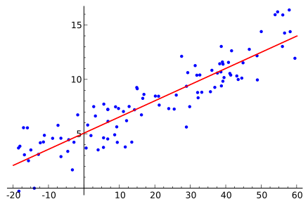
Linear Regression
The linear regression model consists of a predictor variable and a dependent variable related linearly to each other. In case the data involves more than one independent variable, then linear regression is called multiple linear regression models.

Slide 10
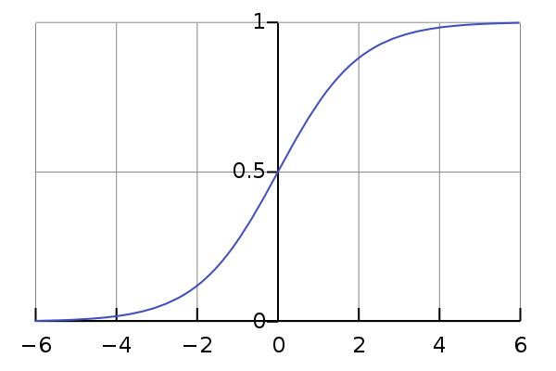
Logistic Regression
Logistic regression is one of the types of regression analysis technique, which gets used when the dependent variable is discrete. Example: 0 or 1, true or false, etc. This means the target variable can have only two values, and a sigmoid curve denotes the relation between the target variable and the independent variable.

Slide 11
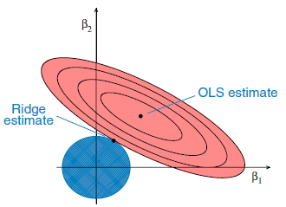
Ridge Regression
This is another one of the types of regression in machine learning which is usually used when there is a high correlation between the independent variables. This is because, in the case of multi collinear data, the least square estimates give unbiased values. But, in case the collinearity is very high, there can be some bias value.

Slide 12
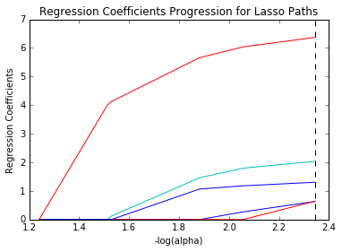
Lasso Regression
Lasso Regression is one of the types of regression in machine learning that performs regularization along with feature selection. It prohibits the absolute size of the regression coefficient. As a result, the coefficient value gets nearer to zero, which does not happen in the case of Ridge Regression.

Slide 13
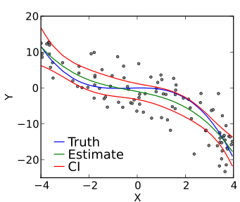
Polynomial Regression
Polynomial Regression is another one of the types of regression analysis techniques in machine learning, which is the same as Multiple Linear Regression with a little modification. In Polynomial Regression, the relationship between independent and dependent variables, that is X and Y, is denoted by the n-th degree.

Slide 14
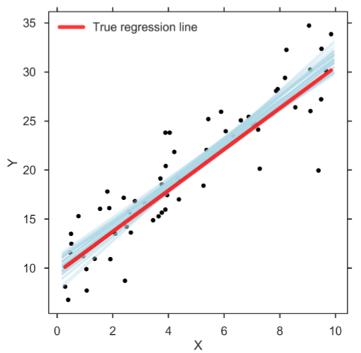
Bayesian Linear Regression
Bayesian Regression is one of the types of regression in machine learning that uses the Bayes theorem to find out the value of regression coefficients. In this method of regression, the posterior distribution of the features is determined instead of finding the least-squares. Bayesian Linear Regression is like both Linear Regression and Ridge Regression but is more stable than the simple Linear Regression.

Slide 15
When should I use regression analysis?
Regression analysis is used when you want to predict a continuous dependent variable from a number of independent variables. If the dependent variable is dichotomous, then logistic regression should be used.

Slide 16
CORRELATION

Slide 17
Correlation is a statistical measure of how to securities move in relation to one another. Basically if two security is usually move in a same wave direction those securities are considered to be correlated. Show the correlation is represented by the correlation coefficient formula.

Slide 18
Types of correlation:
Positive correlation.
Negative correlation.
Linear correlation.
Nonlinear/curvilinear correlation.

Slide 19
Correlation in machine learning:
Correlation explains how one or more variables are related to each other. These variables can be input data features which have been used to forecast our target variable.
The most popular correlation coefficient is pearson's correlation coefficient and it is commonly used in linear regression.

Slide 20
A correlation resource allows you to compute advanced statistics for the fields in your data set by applying various exploratory data analysis techniques to compare the distributions of the fields in your data set against an objective field.

Slide 21
Pearson's correlation coefficient helps you to find out the relationship between two quantities. It gives you the measure of the strength of association between the two variables.

Slide 22
Types of correlation coefficient used in ML and Data Science:
Covariance correlation coefficient.
Pearson's correlation coefficient.
Spearman's correlation coefficient.
Polychoric correlation coefficient.
Correlation coefficients are a useful tool for exploring relationships within your data.

Slide 23
Correlation can be an important tool for feature engineering in building machine learning models. Predictors which are uncorrelated with the objective variable are probably good candidates to to trim from the model. In addition, if two predictors are strongly correlated to each other then we only need to use one of them.

Slide 24
Click here for more info On UpGrad
Click Here For More Info On Bightml

